Slide 1
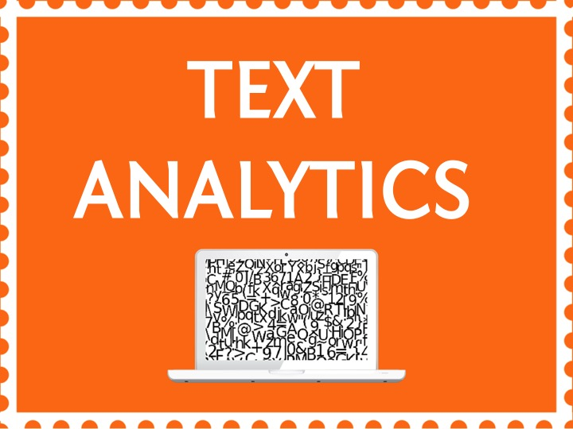

Slide 2
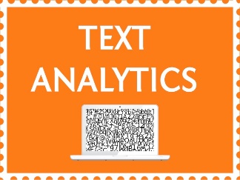

Topic – 1 Intro to Text Mining
Text Analytics
Notes:
Do we know the topic number for this?

Slide 3
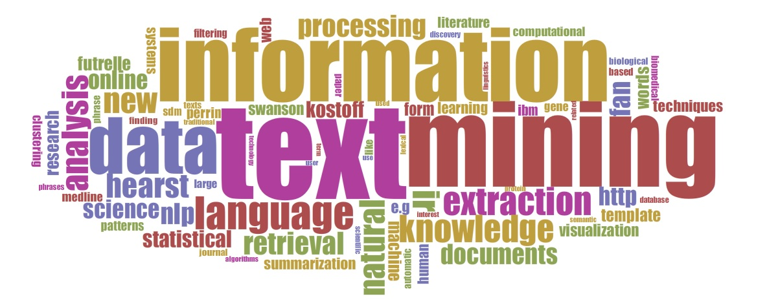

Slide 4


INDEX
Case Study: Book reviews
Need for text mining
Text Mining Process
Challenges of Text Mining
Text Mining Applications
Modelling Techniques
List of Text Mining Techniques
Notes:
Source of information : Reviews from various websites through google search
From this source, we extracted the “dimensions” of the data – which is nothing but the words in the reviews.This adds some implicit structure to the otherwise unstructured data we’re dealing with.
The goal is to identify which are the best books to read.

Slide 5

INDEX
Case Study: Book reviews
Need for text mining
Text Mining Process
Challenges of Text Mining
Text Mining Applications
Modelling Techniques
List of Text Mining Techniques
Notes:
Source of information : Reviews from various websites through google search
From this source, we extracted the “dimensions” of the data – which is nothing but the words in the reviews.This adds some implicit structure to the otherwise unstructured data we’re dealing with.
The goal is to identify which are the best books to read.

Slide 6

Case Study: Book Review
Reap book reviews from various sites
Highlight the best and worst category of books for each genre
Suggest a great book for you to read
Will doing a Google search be an ideal approach?
Notes:
Case Study :
Suppose you wanted recommendations on which books to read?
Will doing a Google search be an ideal approach?

Slide 7
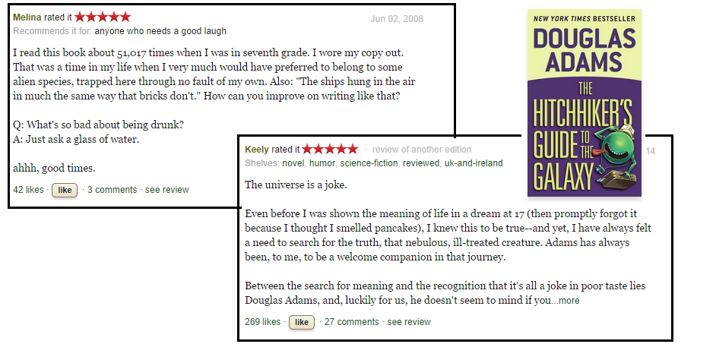
Case Study: Book Review
Notes:
Let’s look at an example :
Suppose you want to find out whether the book “Hitchhikers guide to galaxy” is a good book to read or not.
So you have reaped reviews from various sites:
You read all the reviews of this book.You look at the number of likes and dislikes from various social media sites.
Maybe you might look at what words actually help us identify whether it is a good book or a bad book.
And then you decide whether you want to read this book or not.
But this is more of a search mechanism. It is also quite tedious.

Slide 8
Case Study: Book Review
Research objective:
Find out the best books to read
Data:
Google search sites, reviews (unstructured text information)
Notes:
Source of information : Reviews from various websites through google search
From this source, we extracted the “dimensions” of the data – which is nothing but the words in the reviews.This adds some implicit structure to the otherwise unstructured data we’re dealing with.
The goal is to identify which are the best books to read.

Slide 9
INDEX
Case Study: Book reviews
Need for text mining
Text Mining Process
Challenges of Text Mining
Text Mining Applications
Modelling Techniques
List of Text Mining Techniques
Notes:
Source of information : Reviews from various websites through google search
From this source, we extracted the “dimensions” of the data – which is nothing but the words in the reviews.This adds some implicit structure to the otherwise unstructured data we’re dealing with.
The goal is to identify which are the best books to read.

Slide 10
Need for Text Mining ?
Drawbacks of A “Search” /Information retrieval
Doesn’t help you to discover things you are unaware of
Search results often lack relevance
Helps you find documents, not knowledge
Notes:
Closing Audio to be recorded
Under this topic we have discussed in detail about
…..
That’s it for this topic.
For any queries, do email us at info@jigsawacademy.com
Thanks!

Slide 11
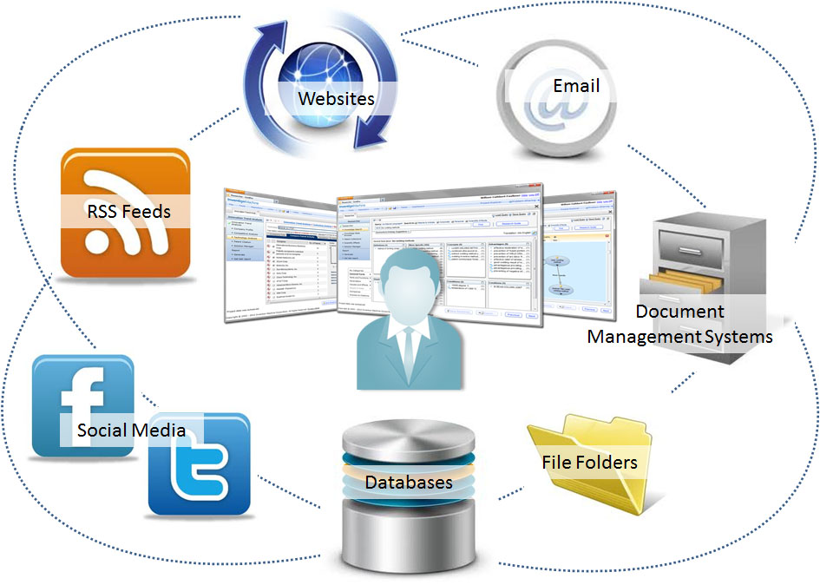
Need for Text Mining ?
90% of the world’s data is unstructured format
Notes:
Closing Audio to be recorded
Under this topic we have discussed in detail about
…..
That’s it for this topic.
For any queries, do email us at info@jigsawacademy.com
Thanks!

Slide 12
Need for Text Mining
Twitter
Blogs
Electronic Medical records(EMR)
Customer feedbacks
Invoices
Unstructured
Data
Examples
Notes:
Closing Audio to be recorded
Under this topic we have discussed in detail about
…..
That’s it for this topic.
For any queries, do email us at info@jigsawacademy.com
Thanks!

Slide 13
INDEX
Case Study: Book reviews
Need for text mining
Text Mining Process
Challenges of Text Mining
Text Mining Applications
Modelling Techniques
List of Text Mining Techniques
Notes:
Source of information : Reviews from various websites through google search
From this source, we extracted the “dimensions” of the data – which is nothing but the words in the reviews.This adds some implicit structure to the otherwise unstructured data we’re dealing with.
The goal is to identify which are the best books to read.

Slide 14
Text Mining Process
Numeric Data (Meaningful Indices)
Used in an analysis or predictive modelling
Unstructured Data
Text Mining = Data mining of text sources
Text Mining = Knowledge Discovery in Text
Notes:
So text mining is the process of converted unstructured data into meaningful indices.
By that we mean numeric data which can be used in predictive modelling.
We’ll look at more methods in following sessions.

Slide 15
Text Mining Process
“Search” Vs “Discover”
Search
(goal-oriented)
Discover
(opportunistic)
Structured
Data
Data
Retrieval
Data
Mining
Unstructured
Data (Text)
Information
Retrieval
Text
Mining

Slide 16
INDEX
Case Study: Book reviews
Need for text mining
Text Mining Process
Challenges of Text Mining
Text Mining Applications
Modelling Techniques
List of Text Mining Techniques
Notes:
Source of information : Reviews from various websites through google search
From this source, we extracted the “dimensions” of the data – which is nothing but the words in the reviews.This adds some implicit structure to the otherwise unstructured data we’re dealing with.
The goal is to identify which are the best books to read.

Slide 17
Challenges of text mining
Very high number of possible “dimensions”
All possible word and phrase types in the language!
Unlike data mining:
Records (= docs) are not structurally identical
Records are not statistically independent
Notes:
Why aren’t there more products that do text mining?
Because it’s hard!!!
First, there are many possible dimensions of text. Consider just the classes of nouns that might be represented in a text collection. Then, add to that noun phrases (nouns plus adjectives or multi-word concepts).
Second, different documents can look quite different. Never mind issues like formatting differences.
Third, the relationships between words and concepts in text is subtle. Figuring out that a relationship exists is easy, providing the information about the nature of the relationship is tricky.
Finally, the same word can have many meanings (e.g. “interest”), or many words can have the same meaning.

Slide 18
Challenges of Text Mining
Complex and subtle relationships between concepts in text
“Cognizant merges with Tata Services”
“Tata Services is bought by Cognizant”
Notes:
Why aren’t there more products that do text mining?
Because it’s hard!!!
First, there are many possible dimensions of text. Consider just the classes of nouns that might be represented in a text collection. Then, add to that noun phrases (nouns plus adjectives or multi-word concepts).
Second, different documents can look quite different. Never mind issues like formatting differences.
Third, the relationships between words and concepts in text is subtle. Figuring out that a relationship exists is easy, providing the information about the nature of the relationship is tricky.
Finally, the same word can have many meanings (e.g. “interest”), or many words can have the same meaning.

Slide 19
Challenges of Text Mining
Complex and subtle relationships between concepts in text
“Cognizant merges with Tata Services”
“Tata Services is bought by Cognizant”
Ambiguity and context sensitivity
automobile = car = vehicle = Toyota
Apple (the company) or apple (the fruit)
Notes:
Why aren’t there more products that do text mining?
Because it’s hard!!!
First, there are many possible dimensions of text. Consider just the classes of nouns that might be represented in a text collection. Then, add to that noun phrases (nouns plus adjectives or multi-word concepts).
Second, different documents can look quite different. Never mind issues like formatting differences.
Third, the relationships between words and concepts in text is subtle. Figuring out that a relationship exists is easy, providing the information about the nature of the relationship is tricky.
Finally, the same word can have many meanings (e.g. “interest”), or many words can have the same meaning.

Slide 20
INDEX
Case Study: Book reviews
Need for text mining
Text Mining Process
Challenges of Text Mining
Text Mining Applications
Modelling Techniques
List of Text Mining Techniques
Notes:
Source of information : Reviews from various websites through google search
From this source, we extracted the “dimensions” of the data – which is nothing but the words in the reviews.This adds some implicit structure to the otherwise unstructured data we’re dealing with.
The goal is to identify which are the best books to read.

Slide 21
Text Mining Applications
Customer Relationship Management (CRM)
Market Analysis
NLP (Natural Language Processing)
Personalization in E-Commerce
Notes:
Use of NLP :
Use of Text Mining techniques to identify
and analyze web pages published in different languages,is one of its example.
When working on a multilingual speech recognition system [32], a good deal of attention must be paid to the languages to be recognized by the system

Slide 22
Text Mining Applications
Customer Relationship Management (CRM)
Market Analysis
NLP (Natural Language Processing)
Personalization in E-Commerce
Notes:
Use of NLP :
Use of Text Mining techniques to identify
and analyze web pages published in different languages,is one of its example.
When working on a multilingual speech recognition system [32], a good deal of attention must be paid to the languages to be recognized by the system

Slide 23
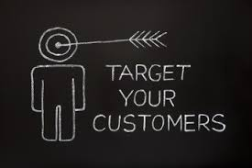
Customer Relationship Management (CRM)
What are customers’ typical complaints?
What is the trend in the number of satisfied customers in Bangalore?
Notes:
In
CRM domain the most widespread applications are
related to the management of the contents of clients’
messages. The customer, the end consumer of
products and services, is receiving increased attention
Customers interacting with contact centers, typically
fill out feedback surveys with free form text comments
which are directly indicative of their (dis)satisfaction with
products, services, or interactions. Currently, only manual
analysis is done, if at all, on a small sample of available
data. Various problem buckets identified by the analysis
can directly lead to actions like improving a particular
agent’s accent, or imparting product training for other
agents. Text classification can help automate this making
it consistent and exhaustive.

Slide 24
Text Mining Applications
Customer Relationship Management (CRM)
Market Analysis
NLP (Natural Language Processing)
Personalization in E-Commerce
Notes:
Use of NLP :
Use of Text Mining techniques to identify
and analyze web pages published in different languages,is one of its example.
When working on a multilingual speech recognition system [32], a good deal of attention must be paid to the languages to be recognized by the system

Slide 25
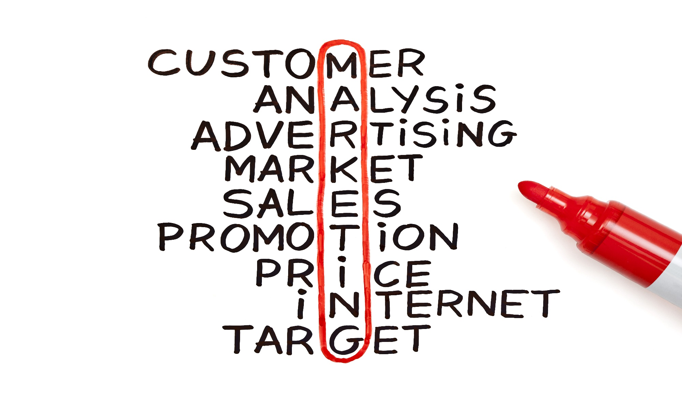
Market Analysis
Notes:
Market analysis is an analysis done to understand the trends in a market for example to sell your product.
It, uses TM mainly
to analyse competitors and/or monitor customers' opinions to identify new potential customers,
as well as to determine the companies’ image through the analysis of press reviews and other relevant sources.
For many companies tele-marketing and e-mail activity represents one of the main sources for acquiring new customers

Slide 26
Text Mining Applications
Customer Relationship Management (CRM)
Market Analysis
NLP (Natural Language Processing)
Personalization in E-Commerce
Notes:
Use of NLP :
Use of Text Mining techniques to identify
and analyze web pages published in different languages,is one of its example.
When working on a multilingual speech recognition system [32], a good deal of attention must be paid to the languages to be recognized by the system

Slide 27

Natural Language Processing (NLP)
Notes:
Definition :
Natural Language Processing(NLP)
Natural language processing (NLP) is a field of computer science, artificial intelligence, and linguistics concerned with the interactions between computers and human (natural) languages.
It deals with analyzing, understanding and generating the languages that humans use naturally in order to interface with computers in both written and spoken contexts using natural human languages instead of computer languages.
Use of NLP :
One application of NLP is that It uses Text Mining techniques to identify and analyze web pages published in different languages,ie it acts as a language translator.

Slide 28
Text Mining Applications
Customer Relationship Management (CRM)
Market Analysis
NLP (Natural Language Processing)
Personalization in E-Commerce
Notes:
Use of NLP :
Use of Text Mining techniques to identify
and analyze web pages published in different languages,is one of its example.
When working on a multilingual speech recognition system [32], a good deal of attention must be paid to the languages to be recognized by the system

Slide 29

Personalization in e-commerce
Product Attributes/Product Reviews
Sentiment analysis
Product Recommendations
Positive : “Classy”
Negative : “Uncomfortable”
Classy Shades, Red Prada Bags,uncomfortable shoes
50% of the customers who bought Shades Also bought Bags.
Notes:
Closing Audio to be recorded
Under this topic we have discussed in detail about
…..
That’s it for this topic.
For any queries, do email us at info@jigsawacademy.com
Thanks!

Slide 30
INDEX
Case Study: Book reviews
Need for text mining
Text Mining Process
Challenges of Text Mining
Text Mining Applications
Modelling Techniques
List of Text Mining Techniques
Notes:
Source of information : Reviews from various websites through google search
From this source, we extracted the “dimensions” of the data – which is nothing but the words in the reviews.This adds some implicit structure to the otherwise unstructured data we’re dealing with.
The goal is to identify which are the best books to read.

Slide 31
Modeling Techniques
Supervised Learning
Unsupervised Learning

Slide 32
Modeling Techniques
Supervised Learning :
Training dataset is the one which is already labelled and uses the classifier algorithm to classify new data based on the labelled data or training data
The test data or unclassified data is going to be classified based on the data available in the training dataset
Examples : Classification techniques for sentiment analysis like SVM, Naïve Bayes, Maximum Entropy, etc
Notes:
Generally for data mining itself, we have two types of modelling techniques:
Supervised
Unsupervised
This can be use for Text mining also.
Supervised Techniques : Mostly classification techniques are used for sentiment analysis.Here you have the training data. You train the dataset and then validate the test
Dataset
For unsupervised techniques : Here we don’t have ttraining and test datasets.You directly classify the words in the document based on an external dictionary.
Eg : clustering, topic modelling, etc

Slide 33
Modeling Techniques
Unsupervised Learning :
Lexicon based approach is also known as the dictionary based approach or semantic based approach
This approach do not require separate training and testing dataset but instead of that list of words or dictionary of words will be used to classify the text data in form of sentence or document
Examples : Clustering, topic modelling, etc
Notes:
Closing Audio to be recorded
Under this topic we have discussed in detail about
…..
That’s it for this topic.
For any queries, do email us at info@jigsawacademy.com
Thanks!

Slide 34
INDEX
Case Study: Book reviews
Need for text mining
Text Mining Process
Challenges of Text Mining
Text Mining Applications
Modelling Techniques
List of Text Mining Techniques
Notes:
Source of information : Reviews from various websites through google search
From this source, we extracted the “dimensions” of the data – which is nothing but the words in the reviews.This adds some implicit structure to the otherwise unstructured data we’re dealing with.
The goal is to identify which are the best books to read.

Slide 35
Text Mining Techniques
Tm package in R
Regular Expressions
Sentiment Analysis
Tweets Network Analysis
Clustering methods
Topic Modelling
Notes:
In this course of text mining, we will look at each of these topics in Detail

